Slide 1


Slide 1
YOUR COFFEE SHOP
INVESTOR OPPORTUNITY

Slide 2


Slide 2
OUR BIG IDEA
Your Coffee Shop’s mission is to become the recognized leader in its target market for providing an outstanding selection of premium bagged coffees and coffee drinks.

Slide 3
Slide 3
INDUSTRY OUTLOOK
20,000
$10B
85%
$50,000
10%
Shops in the USA
In Combined Revenue
Average Gross Margin
In Revenue per Worker
Revenue Increase per Year
SUCCESS

Slide 4
Slide 4
THE MARKET
CUSTOMER SEGMENTATION
21%
36%
29%
7%
7%
Local Residents
Tourists
Passing Travelers
Students
Local Businesses
CUSTOMERS | GROWTH | YR1 | YR2 | YR3
Local Residents | 2% | $15000 | $15300 | $15606
Tourists | 5% | $25000 | $26250 | $27563
Passing travelers | 5% | $20000 | $21000 | $22050
Students | 1% | $5000 | $5050 | $5101
Local Businesses | 1% | $5000 | $5050 | $5101
TOTAL | 2.8% | $70000 | $72650 | $75420

Slide 5
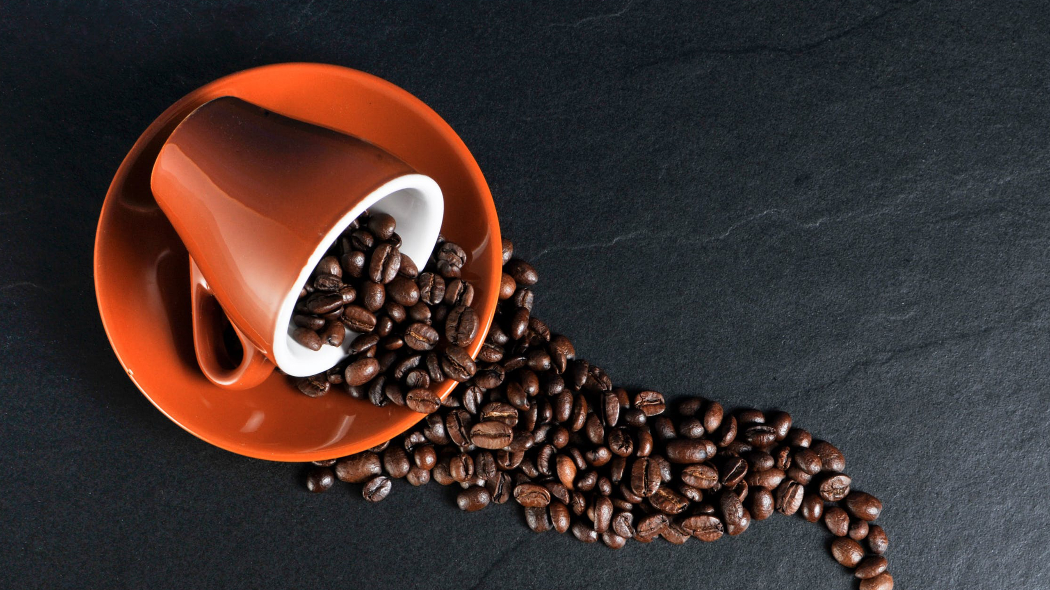

Slide 5
OUR PREMIUM OFFERINGS
Gourmet Bagged Coffee
Deluxe Coffee Drinks
Delicious Local Food

Slide 6
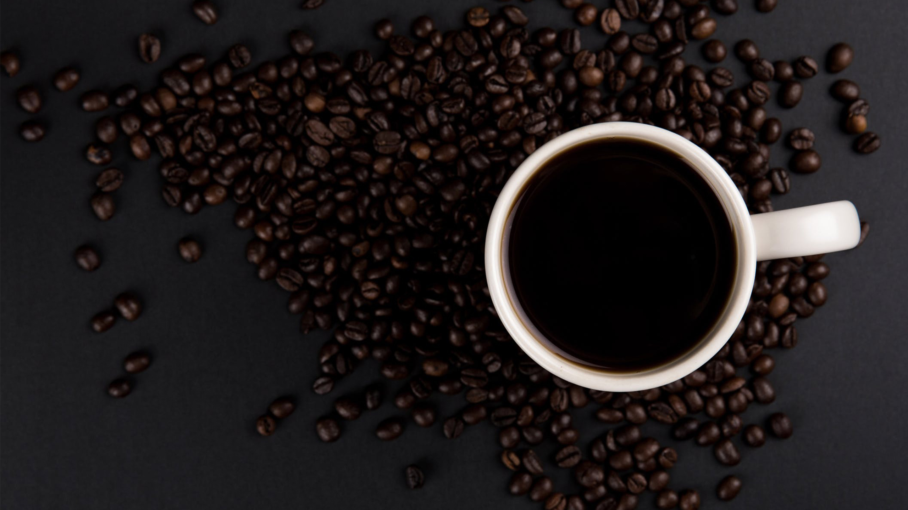
Slide 6
OUR PREMIUM OFFERINGS
Gourmet Bagged Coffee
Deluxe Coffee Drinks
Delicious Local Food

Slide 7
Slide 7
REVENUE MODEL
Bagged Coffee
Coffee Beverages
Local Food
35 to 40 different varieties
Differing flavors, brew strengths, and different regions
Specialized coffee inventories
Priced by the pound
Ranging $4.00 to $40.00 per pound
Average $15.00 per pound. Customers choose coffee ground or not onside
Variety of coffee beverages
Three different size cups
Priced from $2.50 for a 12-ounce drip coffee to $5.75 for a 20-ounce latte
Provides a steady and reliable source of income
Highly predictable and high margin
Direct sale of food products
Locally sourced
Reputable and recognizable vendor and/or chefs.
May include sandwiches, bagels, burritos, pastries, and cookies

Slide 8
Slide 8
SALES FORECAST
3 YEAR SALES SUMMARY | YR1 | YR2 | YR3
TOTAL SALES | $702,000 | $772,200 | $849,420
TOTAL COGS | $212,000 | $222,600 | $233,730
NET PROFIT | $490,000 | $549,600 | $615,690
ANNUAL SALES & GROSS PROFIT

Slide 9
Slide 9
KEY TIMELINE GOALS
Business / Marketing Plan
Secure Funding
Build Out
Grand Opening
Achieve 700+ Daily Customers
2/1/18
5/12/18
8/20/18
11/28/18

Slide 10


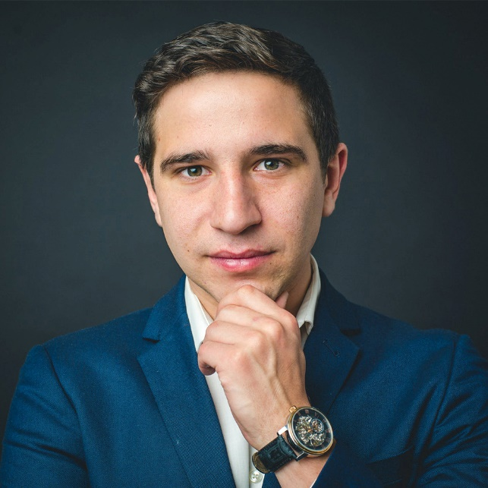
Slide 10
THE TEAM
MANAGER
OWNER
KEY EMPLOYEE
First Last
First Last
First Last

Slide 11
Slide 11
BUSINESS RATIOS
FINANCIAL RATIOS | YR1 | YR2 | YR3
PROFIT MARGIN | 12.07% | 14.95% | 17.66%
ASSETS TO LIABILITIES | 2.83 | 4.24 | 7.44
EQUITY TO LIABILITIES | 1.83 | 3.24 | 6.44
ASSETS TO EQUITY | 1.55 | 1.31 | 1.16
LIQUIDITY RATIOS | YR1 | YR2 | YR3
ACID TEST | 2.34 | 3.66 | 6.67
CASH TO ASSETS | 0.83 | 0.86 | 0.90
SUCCESS RATIOS

Slide 12
Slide 12
MAJOR COMPETITORS
Starbucks – 1 mile
Started the specialty coffee chain phenomena in America in 1982. 99% are company owned. Revenues exceeded $6 billion in 2002. Average store gross revenue is $805,000. Now in 30 countries. Same store sales increased by 10% in 2002.
Caribou Coffee – 2 miles
Second largest all company-owned chains. Founded in 1992 in Minneapolis.
Tully’s – 400 feet
The third largest company-owned chain. Another Seattle-born company. The only coffeehouse chain that has not experienced excellent growth every year; business.com cites poor management as the reason. New management seems to leading a turnaround.

Slide 13
Slide 13
REQUIRED FUNDING
OTHER INVESTMENT
DEBT INVESTOR
$55,000 – 21%
$100,000 – 39%
BANK
OWNER EQUITY
$50,000 – 20%
$50,000 – 20%

Slide 14
Slide 14
USE OF FUNDS
LEASE DEPOSIT 1%
INITIAL LEASE PAYMENTS 3%
FF&E 24%
MISCELLANEOUS COSTS 8%
IMPROVEMENTS 20%
WEBSITE DEVELOPMENT 2%
FIXED STARTUP EXPENSES
RETAIL BUSINESS INSURANCE 2%
WORKING CAPITAL 28%
MARKETING 4%
COFFEE SUPLIES INVENTORY 8%

Slide 15

Slide 15
THANK YOU!
CONTACT US AT:
First Last
First.Last@email.com
123 123 1234

